Slide 1


Data-Driven Storytelling Presentation: How we are achieving the unachievable

Slide 2
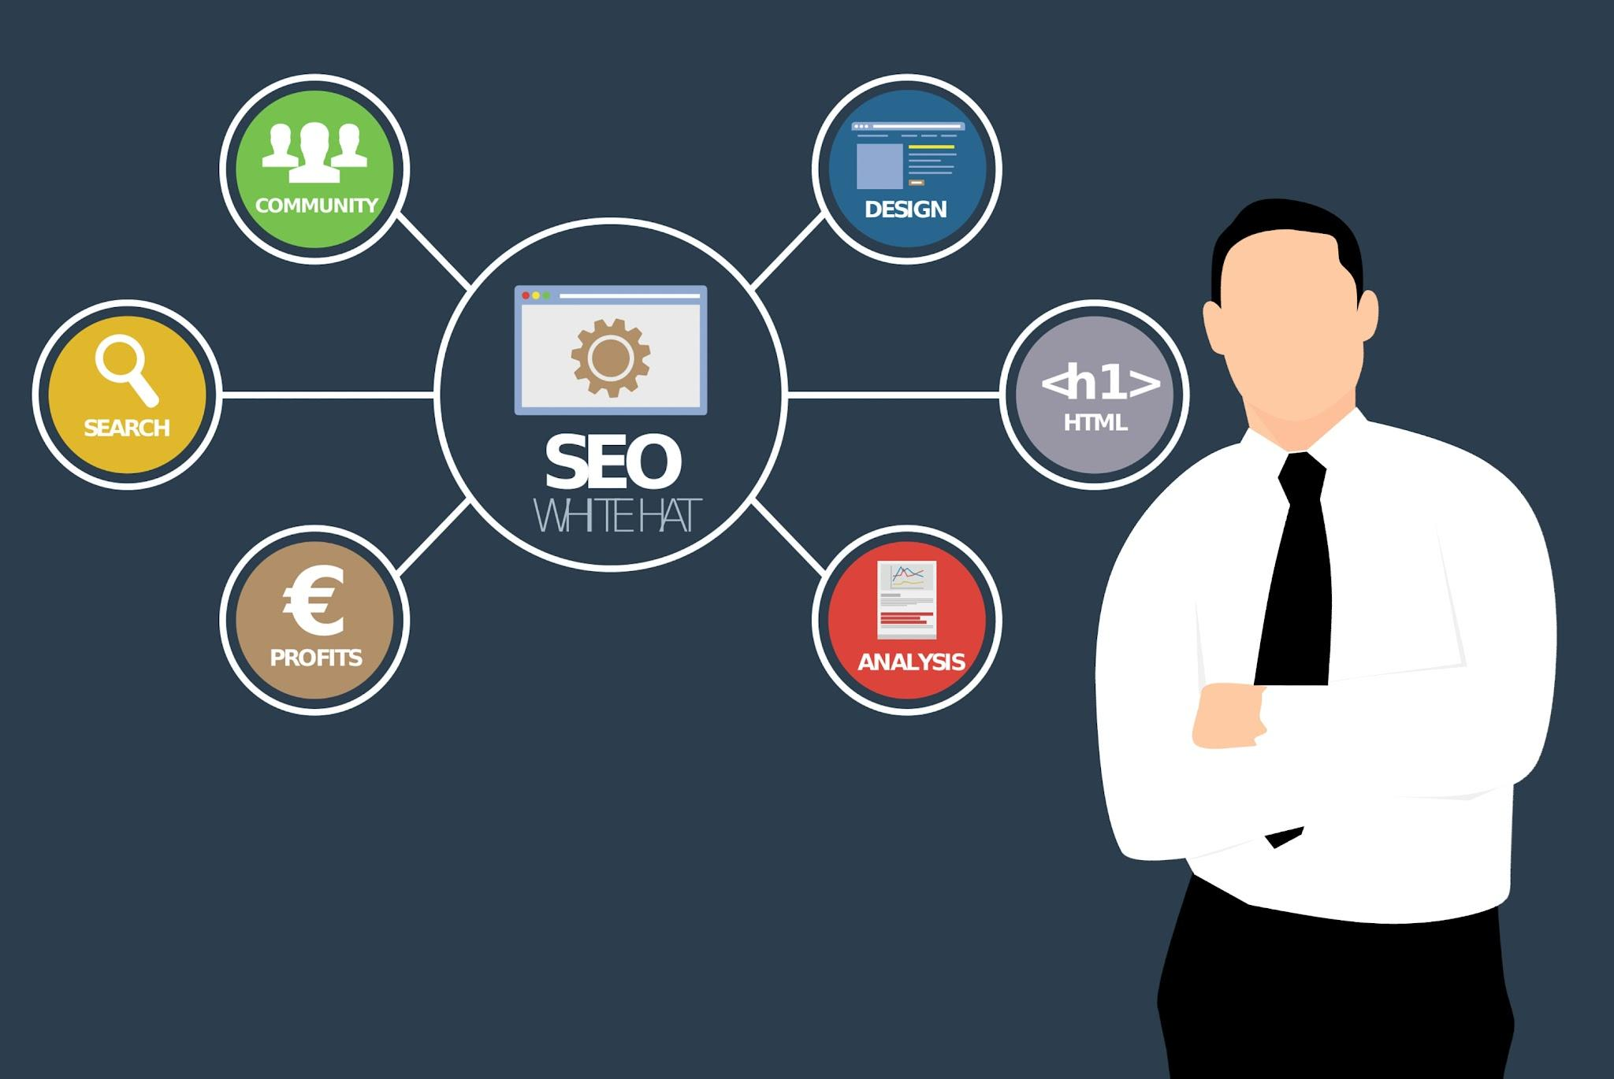
We have achieved the unthinkable in the product selling. Using various marketing techniques we have sold a lot of products to multiple happy customers.

Slide 3

Key point, observation or data here…
Product 1 is the best selling product amongst all products.
Catalog inclusion is the most successful marketing technique
We have given a priority to sales of product 1 in this particular analysis because it is our target product for this research
The growth in the sales of the product primary has risen constantly over the years
maximum is in the year 2021 which is also our target year.
A certain few products have shown massive 5 year CAGR improvement of over 100% while some have also seen negative inclination.

Slide 4

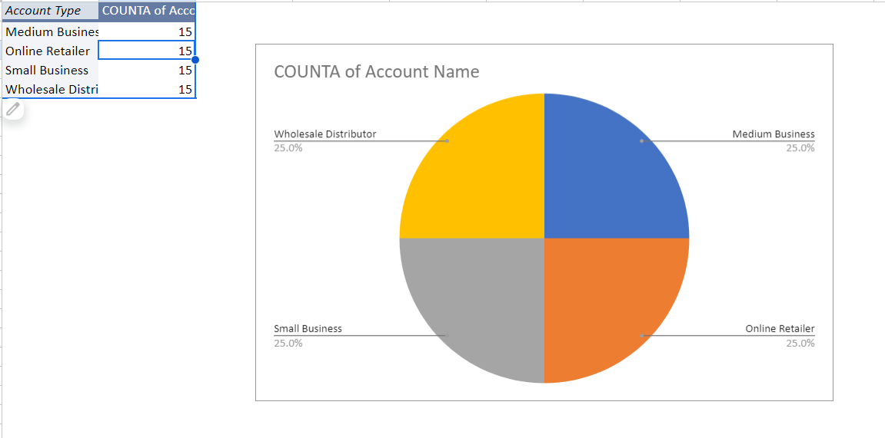
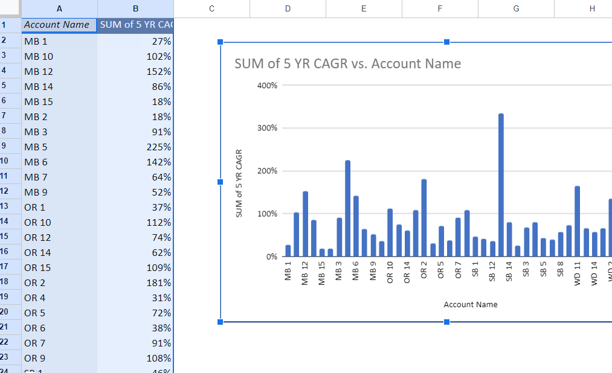
Summary
The improvements in the sale of product 1 is clearly to be seen with our analysis as shown prior.
it has increased over the years
people have taken interest in buying that particular product

